Slide 1






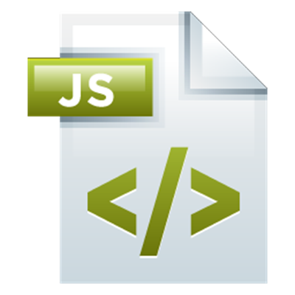
MongoDB And Mongoose
The most used Node.js database
Express.js Development
SoftUni Team
Technical Trainers
Software University
http://softuni.bg

Slide 2

Table of Contents
MongoDB Overview
Mongoose Overview
Mongoose Models
Mongoose CRUD operations
Mongoose Queries

Slide 3
Have a Question?
sli.do #express-js

Slide 4
MongoDB Native Overview
The Normal Way

Slide 5
Using MongoDB
Download MongoDB from the official web site:
https://www.mongodb.org/downloads
Installers for all major platforms
When installed, MongoDB needs a driver to be usable with a specific platform
One to use with Node.js, another to use with .NET, etc…
Installing MongoDB driver for Node.js:
$ npm install mongodb -g

Slide 6
Working with MongoDB
Once installed, MongoDB must be started
Go to installation folder and run mongod --dbpath "path/to/data"
Default is
You may add this folder to the global PATH
When run MongoDB can be used from Node.js
https://docs.mongodb.com/manual/tutorial/install-mongodb-on-windows/
C:\Program Files\MongoDB\Server\3.2\bin

Slide 7
Working with MongoDB Shell Client
Start the shell from another CLI
The mongo command
https://docs.mongodb.com/manual/reference/mongo-shell/
$ show dbs
$ use somedatabase
$ db.mycollection.insert({"name":"IK"})
$ db.mycollection.insert({"name":"SN"})
$ db.mycollection.find({"name":"IK"})
$ db.mycollection.find({})

Slide 8
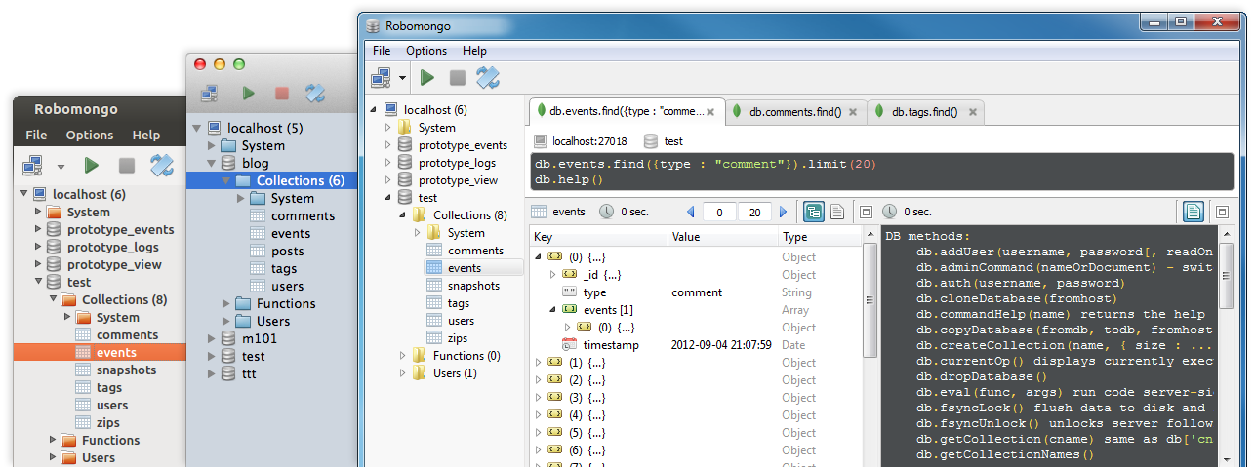
Working with MongoDB GUI
Choose one of the many
For example https://robomongo.org/download

Slide 9
Visual Studio Code Intellisense
Install typings globally
npm install typings --global
Run the following to install mongodb intellisense
typings install mongodb --save
The same can be used for all other modules with intellisense
typings install express --save

Slide 10
Working with MongoDB from Node.js
const mongodb = require('mongodb')
let connection = 'mongodb://localhost:27017/mydatabase'
mongodb.MongoClient.connect(connection, (err, db) => {
let students = db.collection('students')
students.insertMany([
{ name: 'Ivan' },
{ name: 'George' }
], (err, result) => {
students.find({ name: 'Ivan' }).toArray((err, data) => {
console.log(data)
})
})
})

Slide 11
Mongoose Overview
The Cool Way

Slide 12
Mongoose Overview
Mongoose is a object-document model module in Node.js for MongoDB
Wraps the functionality of the native MongoDB driver
Allows defining strong schema
Exposes models to control the records in a doc
Supports validation on save
Extends the native queries
Much more easier to use

Slide 13
Installing Mongoose
Run the following from the CMD/Terminal
In Node
Load the module
Connect to the database
Create models and store their data
$ npm install mongoose
let mongoose = require('mongoose')
mongoose.connect(connection)
var Unit = mongoose.model('Unit', { type: String} );
new Unit({type: 'warrior'}).save(callback); //create
Unit.find({type: 'warrior'}).exec(callback); //fetch

Slide 14
Complete Example
let Cat = mongoose.model('Cat', {
name: { type: String, default: '' },
age: { type: Number, default: 0 }
})
let Owner = mongoose.model('Owner', {
name: { type: String, required: true, index: true, unique: true },
cats: [Cat.schema]
})
mongoose.connect(connection).then(() => {
let myrkins = new Cat({ name: 'Myrkins', age: 1 })
let malcho = new Cat({ name: 'Malcho', age: 1 })
new Owner({ name: 'IK', cats: [myrkins, malcho] })
.save().then((ik) => {
console.log(ik)
})
})

Slide 15
Mongoose Models
And Their Schema

Slide 16
Mongoose Models
Mongoose supports models
Fixed types of documents
Used like object constructors
Needs a mongoose.Schema call
var modelSchema = new mongoose.Schema({
propString: String,
propNumber: Number,
propObject: {},
propArray: [],
propBool: Boolean
});
var Model = mongoose.model('Model', modelSchema);

Slide 17
Model Methods
Since mongoose models are just JavaScript object constructors they can have methods
And these methods can be added to a schema
Use a different syntax than plain JS
let unitSchema = new mongoose.Schema({…});
unitSchema.methods.move = function(to){
…
};
var unit = new Unit({ … } );
unit.move({x: 5, y: 6});

Slide 18
Model Virtual Properties
Yet, not all properties need to be persisted to the database
Mongoose provides a way to create properties, that are accessible on all models, but are not persisted to the database
And they have both getters and setters
catSchema.virtual('introduction').get(function () {
return this._someValue
})
catSchema.virtual('introduction').set(function (value) {
this._someValue = value
})

Slide 19
Property Validation
With Mongoose developers can define custom validation on their properties
Validate records when trying to save
var unitSchema = new mongoose.Schema({…});
unitSchema.path('position.x').validate(function(value){
return value>=0 && value <= maxX;
}, 'Error message!!!');
unitSchema.path('position.y').validate(function(value){
return value >= 0 && value <= maxY;
}, 'Error message!!!');

Slide 20
CRUD with Mongoose
Create, Read, Update, Delete

Slide 21
CRUD with Mongoose
Mongoose supports all the CRUD operations:
Create –> modelObj.save(callback)
Read –> Model.find().exec(callback)
Update –> modelObj.update(props, callback) –> Model.update(condition, props, cb)
Remove –> modelObj.remove(callback) –> Model.remove(condition, props, cb)

Slide 22
Create
let mongoose = require('mongoose')
mongoose.Promise = global.Promise
let connection = 'mongodb://localhost:27017/catcollection'
let catSchema = new mongoose.Schema({
name: { type: String, required: true, minlength: 3 },
age: Number
})
let Cat = mongoose.model('Cat', catSchema)
mongoose.connect(connection).then(() => {
new Cat({ name: 'Kittens', age: 2 }).save()
.then(kittens => {
console.log(kittens._id)
})
})

Slide 23
Read
Cat
.find({})
.exec()
.then(cats => console.log(cats))
Cat
.find({name: 'Kitty'})
.exec()
.then(cats => console.log(cats))
Cat
.findOne({name: 'Kittens'})
.exec()
.then(cat => console.log(cat))

Slide 24
Update
Cat
.findById('57fb9fe1853ab747b0f692d1')
.exec()
.then(cat => {
cat.name = 'NewCatName'
cat.save()
})
Cat
.findByIdAndUpdate('57fb9fe90cd76e4e2c59e1a2', {
$set: { name: 'Kotangens' }
})
.exec()
Cat
.update(
{ name: 'Kittens' },
{ $set: { name: 'NoMoreKittens' } },
{ multi: true })
.exec()

Slide 25
Remove & Count
Cat
.findByIdAndRemove('57fb9fe1853ab747b0f692d1')
.exec()
Cat
.remove({ name: 'NoMoreKittens' })
.exec()
Cat
.count()
.exec()
.then(console.log)
Cat
.count({ age: { $gt: 2 } })
.exec()
.then(console.log)

Slide 26
Mongoose Queries
Chain, chain, chain

Slide 27
Mongoose Queries
Mongoose defines all queries of the native MongoDB driver in a more clear and useful way
Instead of:
Do:
{
$or: [
{conditionOne: true},
{conditionTwo: true}
]
}
.where({ conditionOne: true }).or({ conditionTwo: true })

Slide 28
Mongoose Queries
Mongoose supports many queries:
For equality/non-equality
Selection of some properties
Sorting
Limit & skip
All queries are executed over the object returned by Model.find*()
Call .exec() or .then() at the end to run the query

Slide 29
Mongoose Queries
JSON
Person.
find({
occupation: /host/,
'name.last': 'Ghost',
age: { $gt: 17, $lt: 66 },
likes: { $in: ['vaporizing', 'talking'] }
}).
limit(10).
sort({ occupation: -1 }).
select({ name: 1, occupation: 1 }).
exec(callback);

Slide 30
Mongoose Queries
Query builder:
Person.
find({ occupation: /host/ }).
where('name.last').equals('Ghost').
where('age').gt(17).lt(66).
where('likes').in(['vaporizing', 'talking']).
limit(10).
sort('-occupation').
select('name occupation').
exec(callback);

Slide 31
Mongoose Modules
Separating The Data Layer

Slide 32
Mongoose Models
Having all model definitions in the main module is no good
That is the reason Node.js has modules in the first place
We can put each model in a different module, and load all models at start

Slide 33
Mongoose Models
In folder models, file Cat.js:
Where it is needed:
let mongoose = require('mongoose')
let catSchema = new mongoose.Schema({
name: { type: String, required: true, minlength: 3 },
age: Number
})
mongoose.model('Cat', catSchema)
module.exports = mongoose.model('Cat')
let Cat = require('./models/Cat')

Slide 34








JavaScript Web – Express.js Fundamentals
https://softuni.bg/trainings/1434/node-js-development-september-2016

Slide 35

License
This course (slides, examples, demos, videos, homework, etc.) is licensed under the "Creative Commons Attribution-NonCommercial-ShareAlike 4.0 International" license
Attribution: this work may contain portions from
"End-to-end JavaScript Applications" course by Telerik Academy under CC-BY-NC-SA license

Slide 36





Free Trainings @ Software University
Software University Foundation – softuni.org
Software University – High-Quality Education, Profession and Job for Software Developers
softuni.bg
Software University @ Facebook
facebook.com/SoftwareUniversity
Software University @ YouTube
youtube.com/SoftwareUniversity
Software University Forums – forum.softuni.bg

